Slide 1

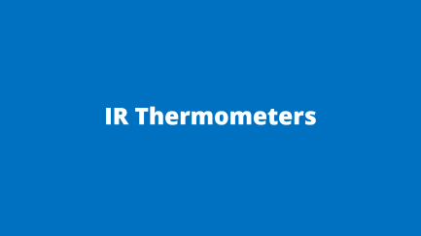
How to make a Pulse Oximeter
A technical perspective.
By Pulasthi Ekanayake

Slide 2
Pulse Oximeters

Slide 3
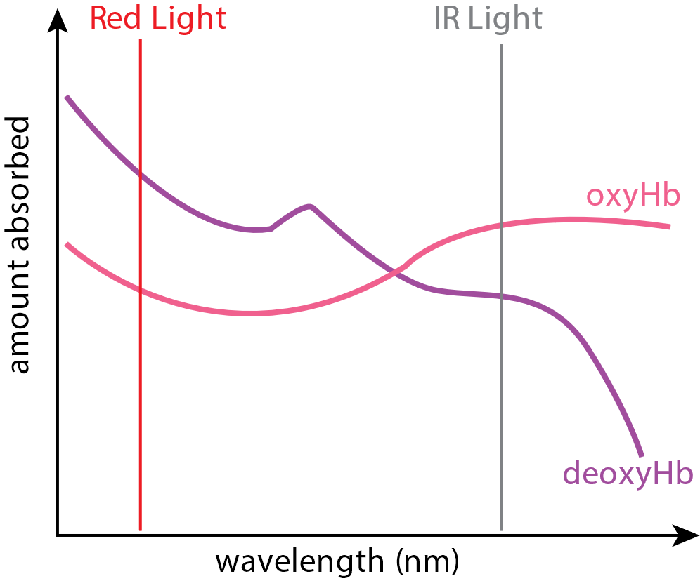
Working Principle
Light is absorbed and scattered by blood and tissues
Oxygenated hemoglobin (Hb) and Deoxygenated Hb absorb wavelengths
The ratio of absorbed light can be used to find the % of oxygen in blood.
Indirect measurement needs calibration
Amount of Light absorbed at different wavelengths
Condition | SPO2 level
Normal | 95% to 100%
Low Oxygen (Hypoxemia) | Below 90%
Brain Gets Affected | 85% to 80%
Blue Skin (Cyanosis) | Below 67%

Slide 4
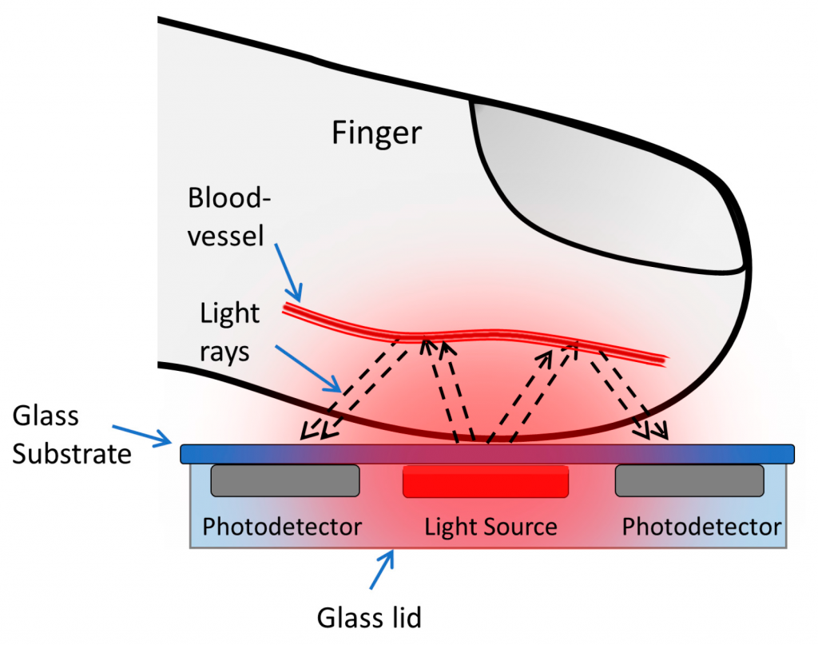
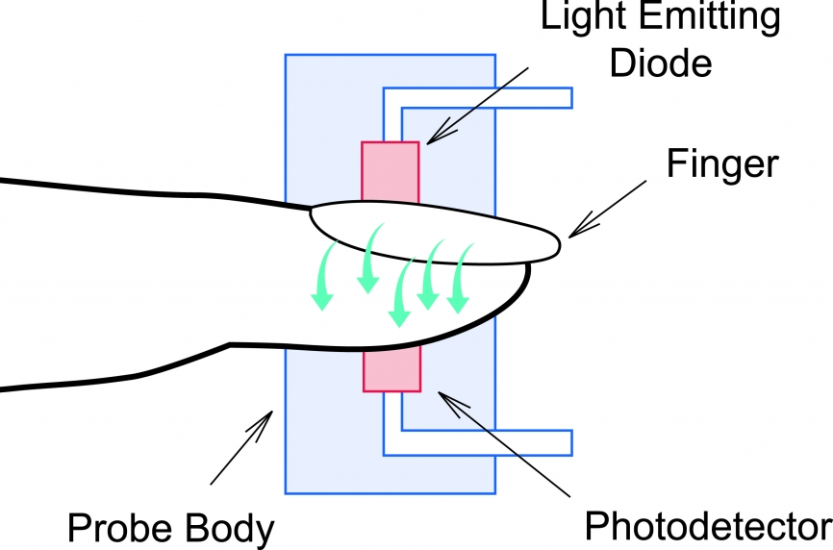
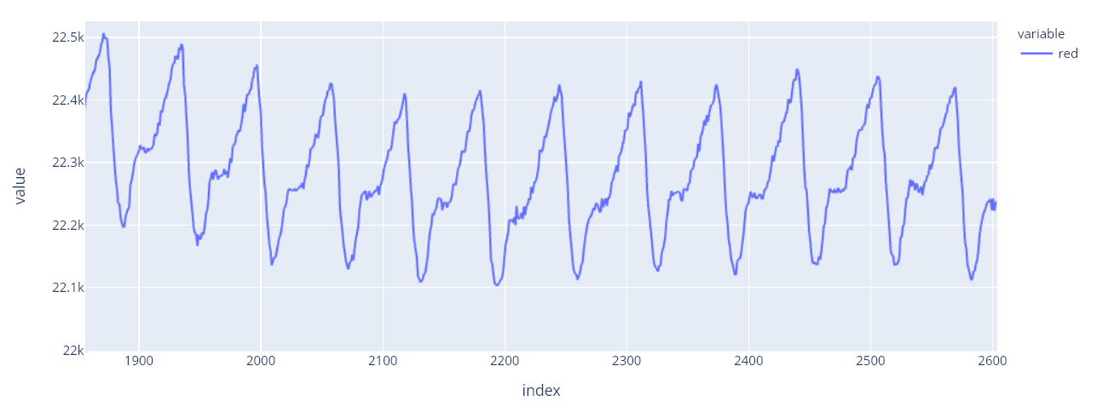
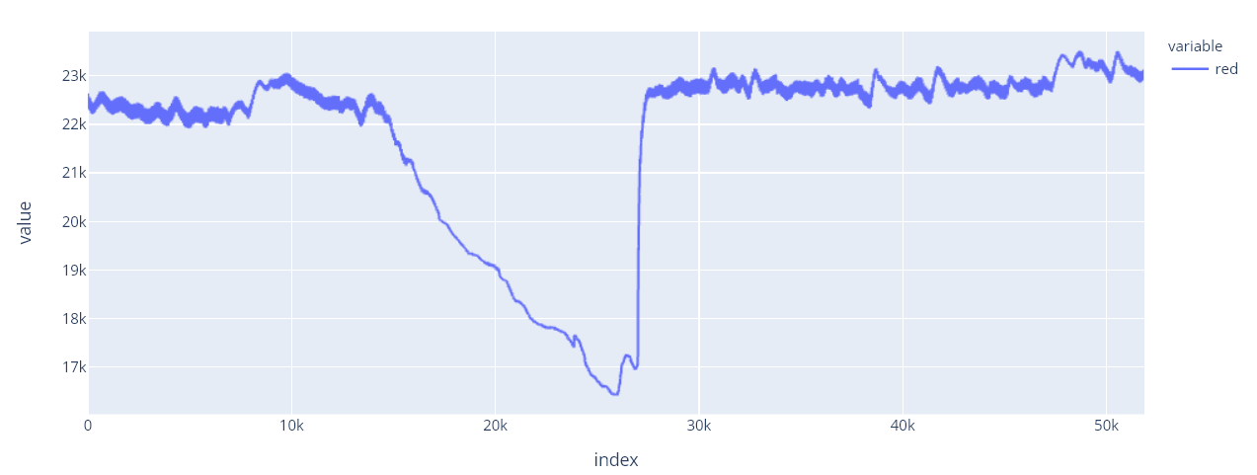
Sensors
Types of sensors
Transmissive – Patient Monitors
Reflective – Fitness Trackers
MAX30100 (reflective)
Fig: Short term variation.
Fig: Long term variation. The drop in value happens when the blood flow is stopped by a pressure cuff
Learn more : https://www.ti.com/lit/an/slaa655/slaa655.pdf?ts=1630158297119

Slide 5
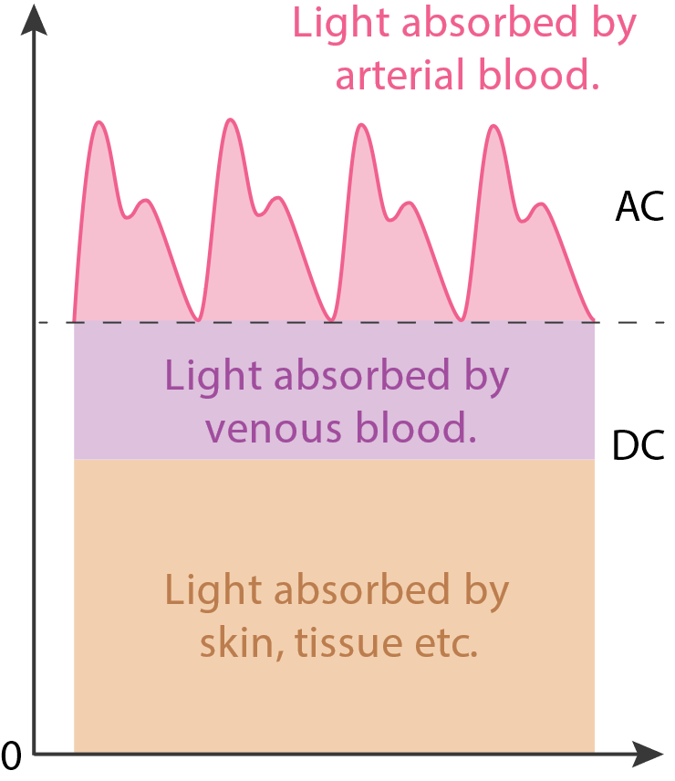
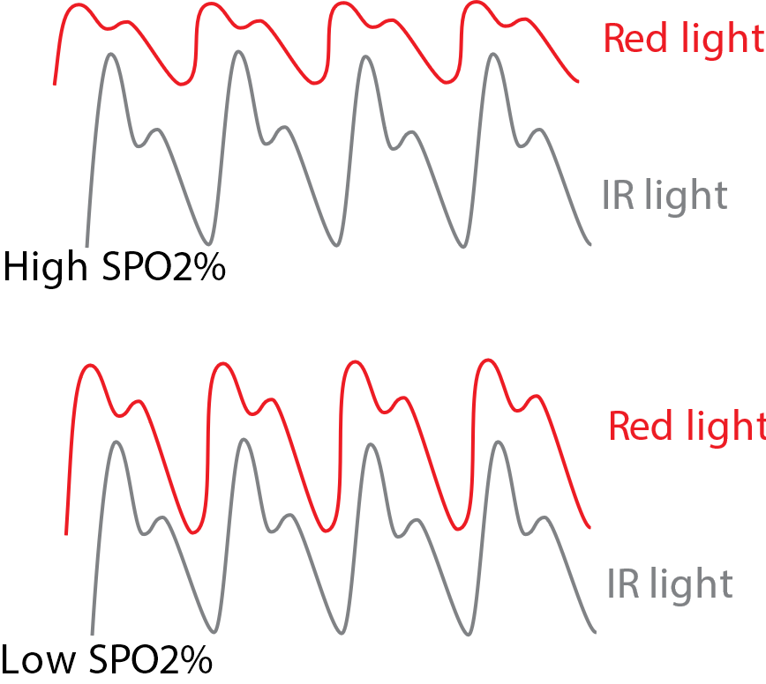
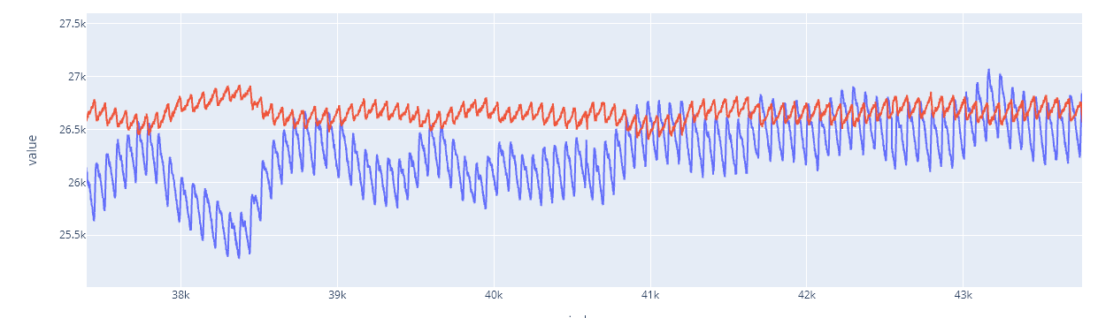

SPO2 Calculation
Standard Equation
$$R = \frac{({AC}_{rms} of Red/DC of Red)}{({AC}_{rms} of IR/DC of IR)}$$
$$SPO2\%= 110 − 25 × R$$
An alternative equation
$$R= \frac{\log_{10}{({Intensity of Red Light}_{ac})}}{\log_{10}{({Intensity of IR Light}_{ac})}}$$
$$SPO2 \% = 100 ∗ R$$
Light is absorbed/ reflected by different things
Telling SPO2 from observation
Actual data. Red and IR values have two different scales

Slide 6
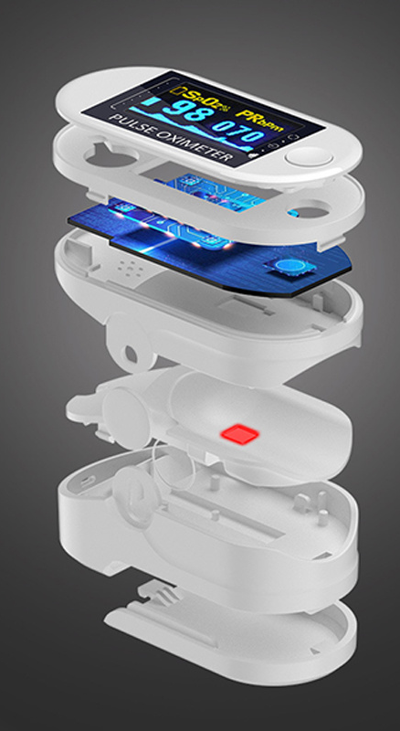
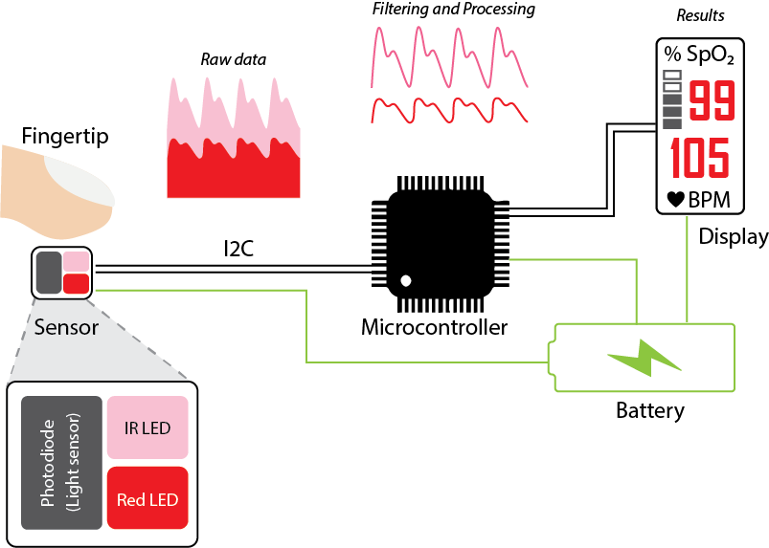
Block Diagram

Slide 7
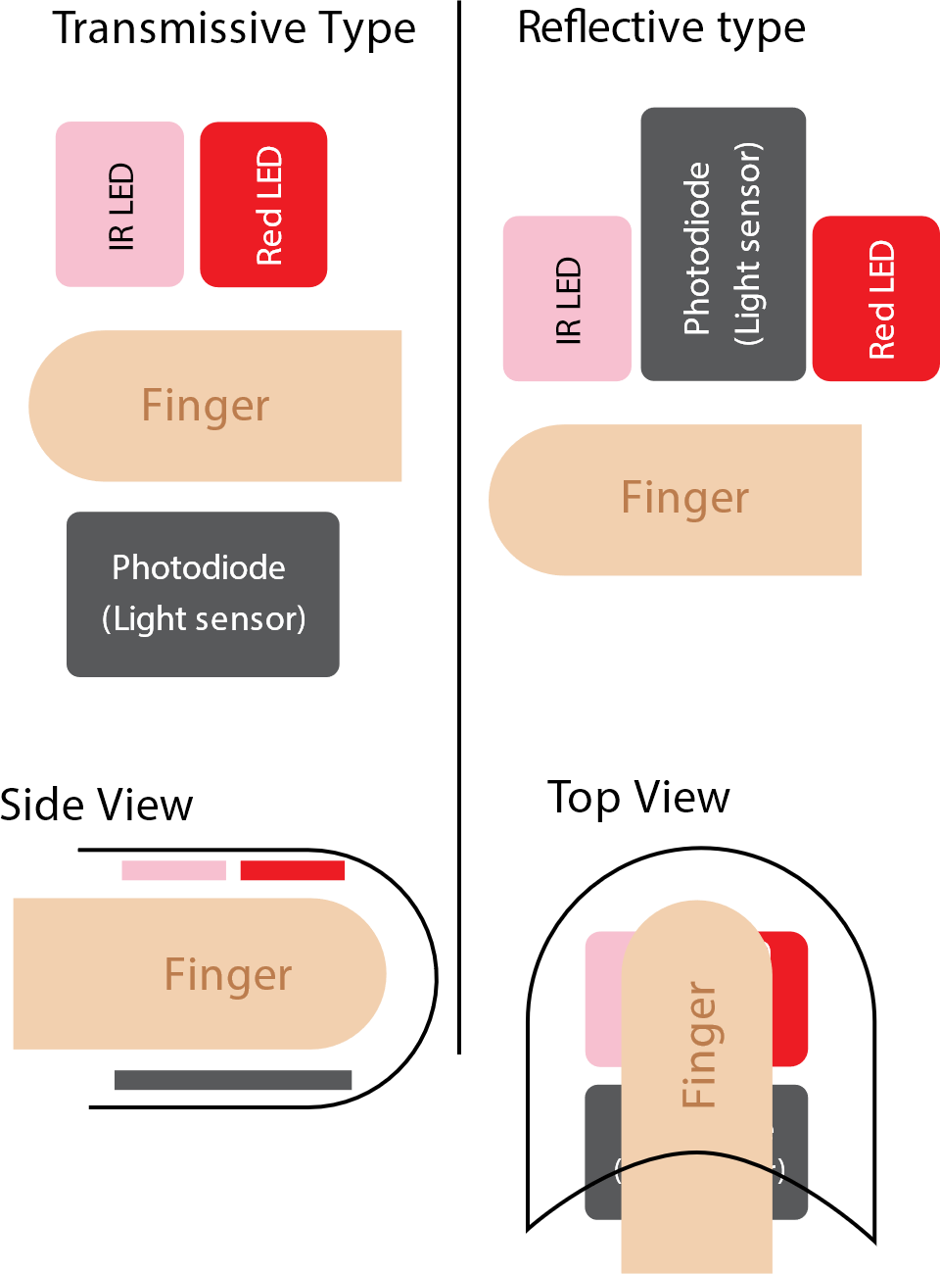
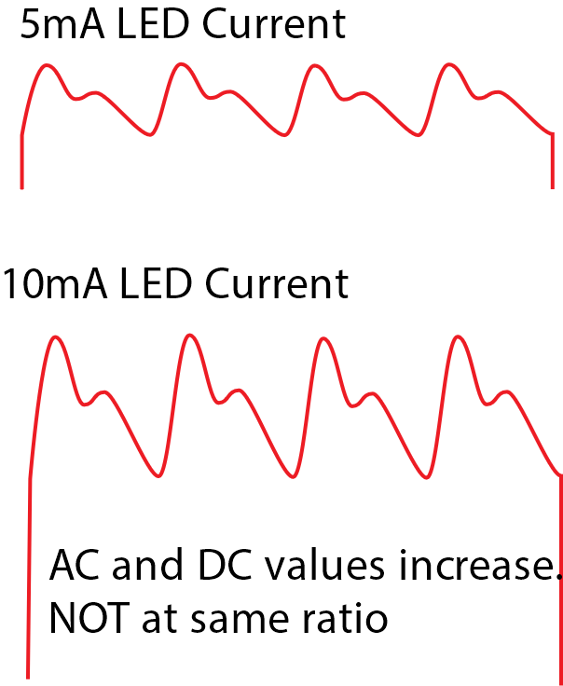
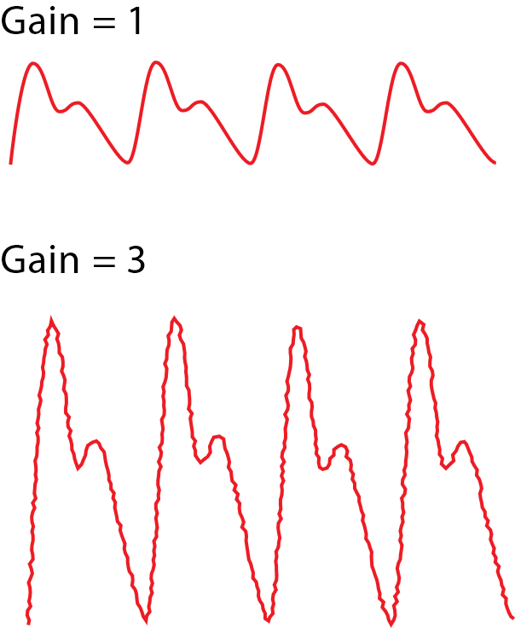
Configurable Settings
Placement of Sensors
LED Current
Transimpedance Amplifier Gain

Slide 8
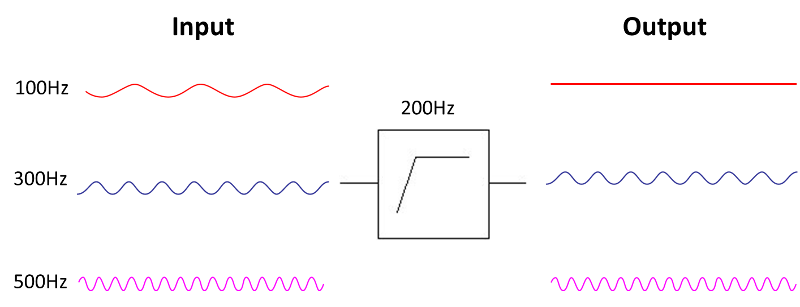
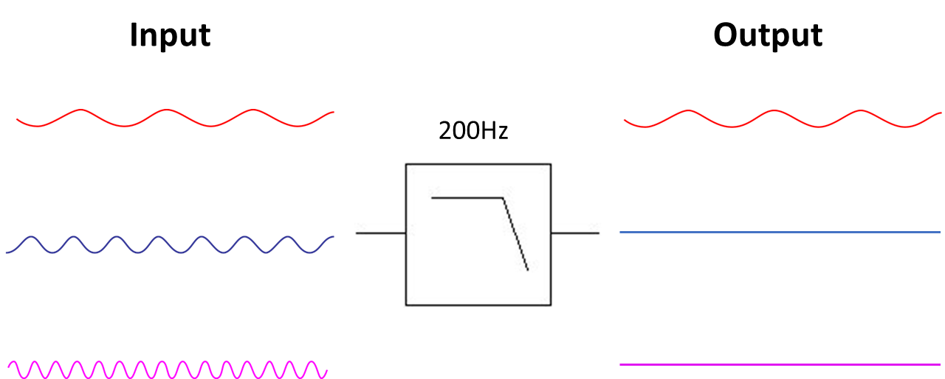
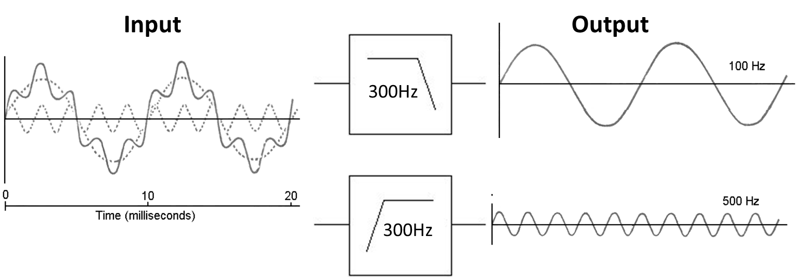
Filters - Basics
High Pass filters
Low Pass filters

Slide 9
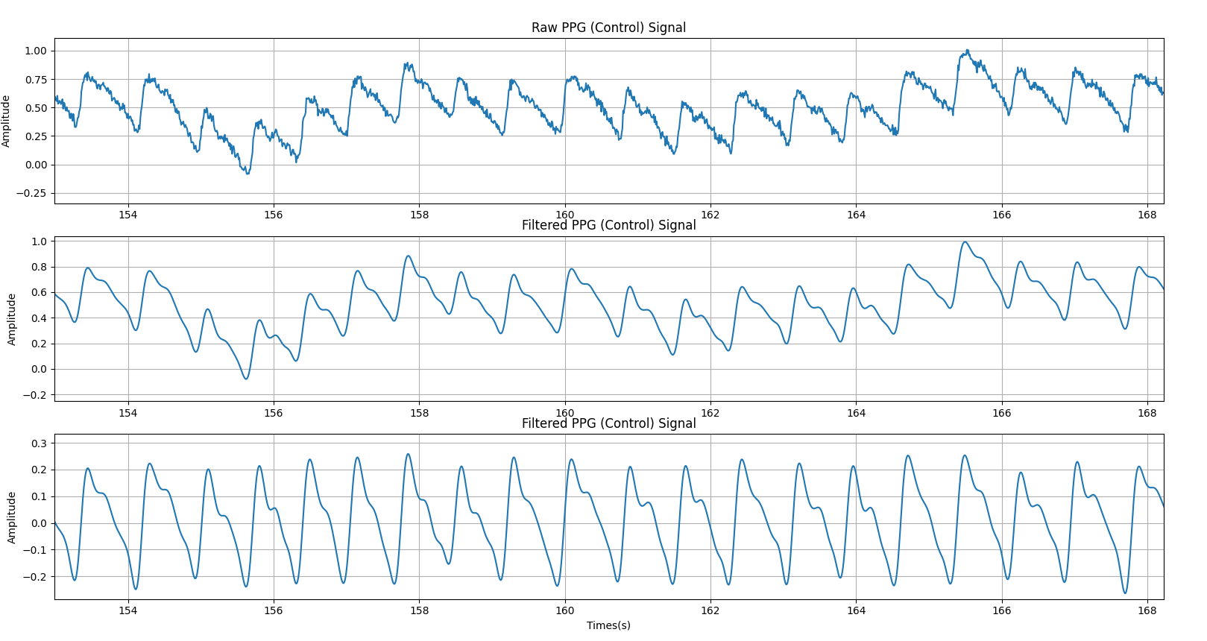
Filtering
Low pass - 6Hz to eliminate high frequency noise
Notch Filter - 50Hz filter to eliminate powerline noise (Optional)
Add an voltage offset of VCC/2 so that AC is not clipped when the DC component is removed.
High pass - 0.8Hz to remove DC component of signal
Optional - Active low pass - 6Hz and gain of 31

Slide 10
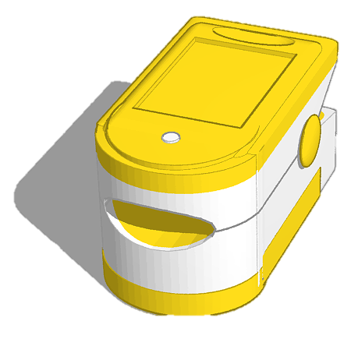
Special considerations
Ambient light - noise cancellation & DC offset correction to subtract the noise introduced due to ambient light in order to improve the signal-to-noise ratio (SNR).
Temperature - compensation for eliminating effects of temperature drift on LED driver and photo-diode sensing
Movement - Use a clip like enclosure to prevent relative motion
Spacing - the finger should not be tightly pressed on the sensor if using reflective type sensors.
Skin color - include a calibration step
Safety - PPG sensors are safe. Do not leave exposed metal parts and use low voltages.

Slide 11
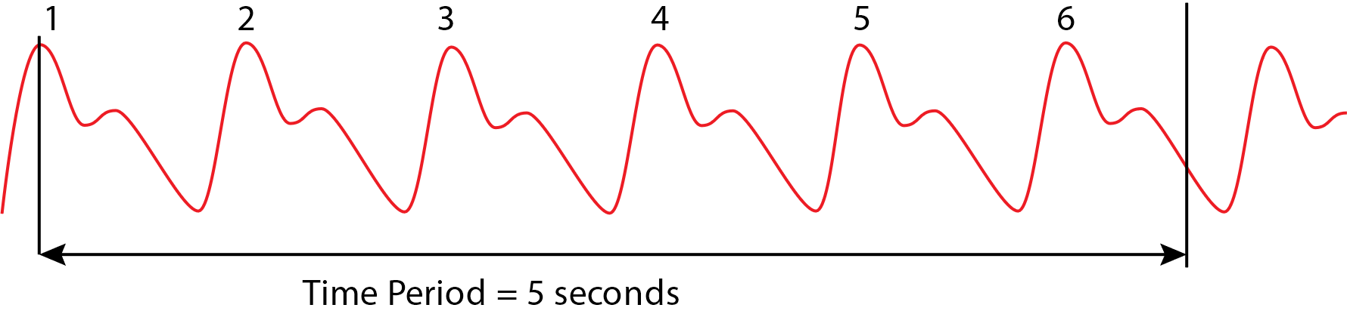
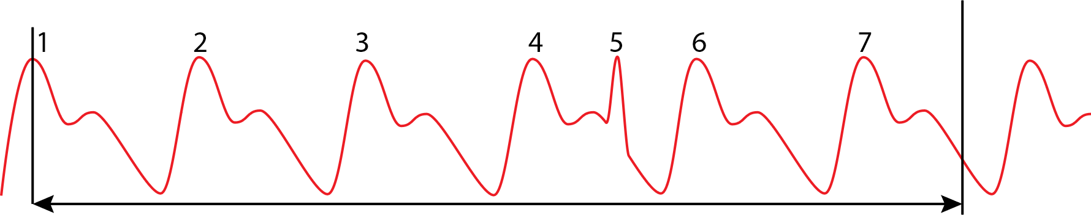
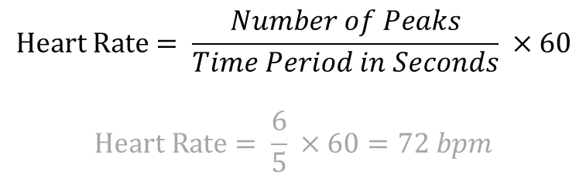
Heart Rate
$$Heart Rate= \frac{Number of Peaks}{Time Period in Seconds} ×60$$
$$Heart Rate= \frac{6}{5} ×60=72 bpm$$
Possible Issues – Peaks created by motion

Slide 12
IR Thermometers

Slide 13
Block Diagram

Slide 14
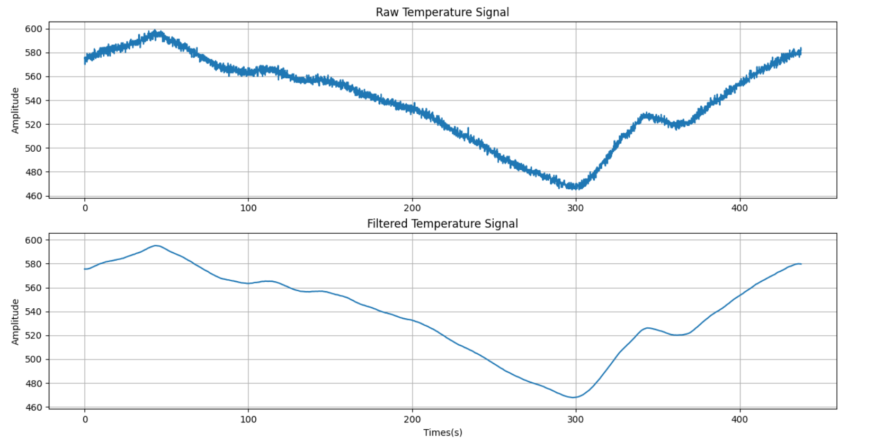
Filtering
Low pass filter 0.1Hz

Slide 15
Thank You

